Slide 1
EMPLOYEE PERFORMANCE ANALYSIS SYSTEM
KARUNAKAR UPPALPATI
M70733630

Slide 2
Introduction:
The Effective employee performance analysis is essential for organizational success in the fast-paced commercial world of today. Particularly in larger companies, the outdated techniques of assessing employee performance—which frequently entail laborious manual processes of data collecting and analysis—are becoming less and less effective. By importing data from multiple sources into a centralized database, computing key performance indicators (KPIs), and presenting this information in an understandable style, this project suggests developing an automated system to expedite the review process. The goal of this system is to improve decision-making processes so that performance management interventions can be made on time and with greater accuracy.

Slide 3
Goal:
The main goal of this project is to create an automated system for analysing employee performance that will efficiently gather and process employee performance data in order to support better management decision-making. By improving the efficiency and accuracy of performance reviews, this method seeks to improve internal resource management and strategic planning in a business.
Objectives:
1) Data Integration: To provide a method for bringing information into a centralized database from several sources (attendance records, productivity measures, and performance appraisals). This will guarantee that all pertinent data is accessible for thorough study in one location.
2) Performance Metrics Calculation: Automate the computation of key performance indicators (KPIs) such as productivity (the number of tasks finished in a given amount of time), attendance (the percentage of scheduled work hours attended), quality of work (determined by performance reviews or customer feedback), and deadline adherence (the percentage of tasks finished on time). 3) Results Presentation: To create an intuitive user interface that lets managers quickly discover high-performing staff members and areas in need of improvement, as well as simply choose the targeted KPIs and see the data in both graphical and tabular formats.

Slide 4
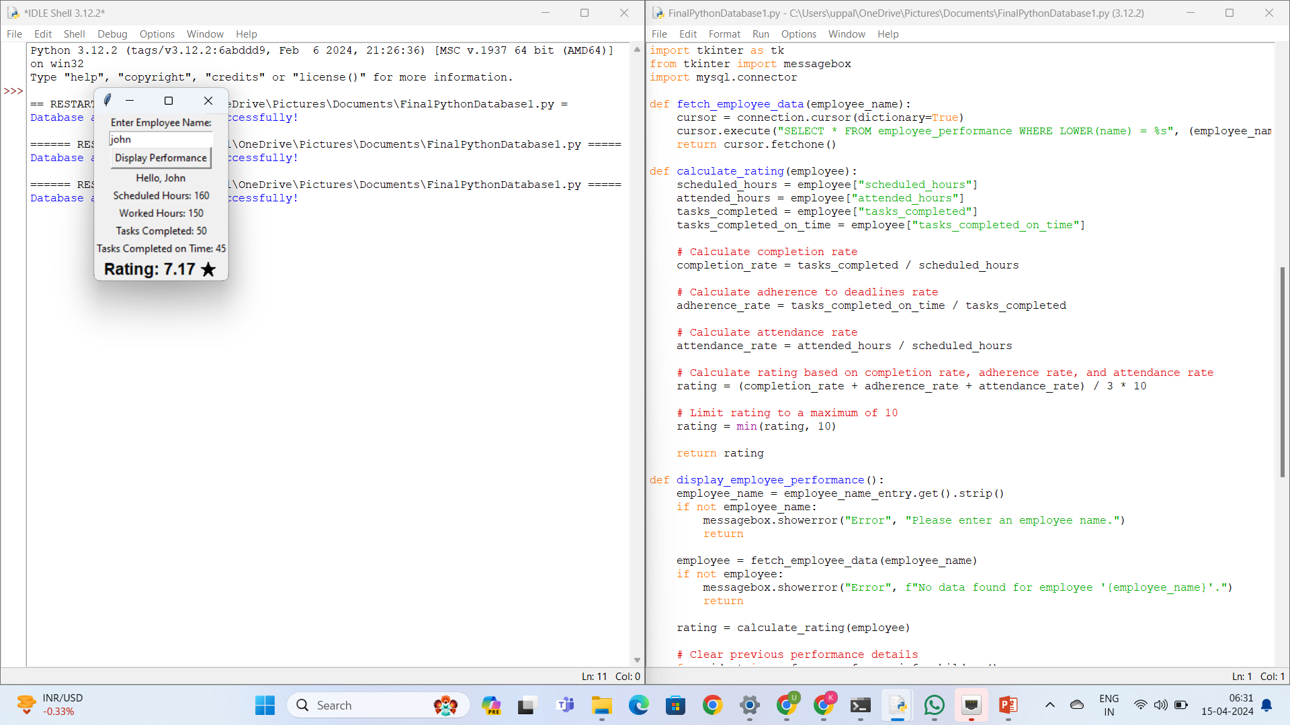

Slide 5
Conclusion:
The Employee Performance Analysis System improves organizational efficiency and decision-making by streamlining the assessment of performance metrics. The system saves time and minimizes errors by automating data collection and analysis, enabling managers to promptly discover areas for improvement and take appropriate action

